Slide 1
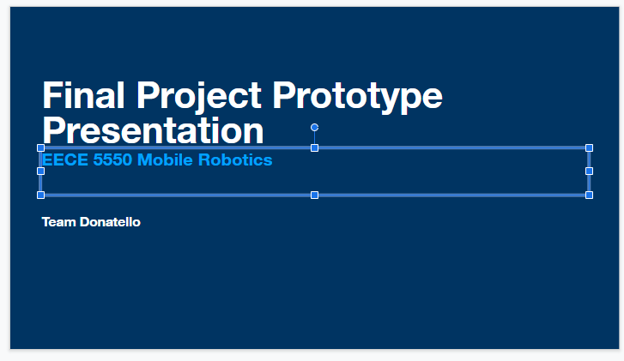

Yin go through this part

Slide 2
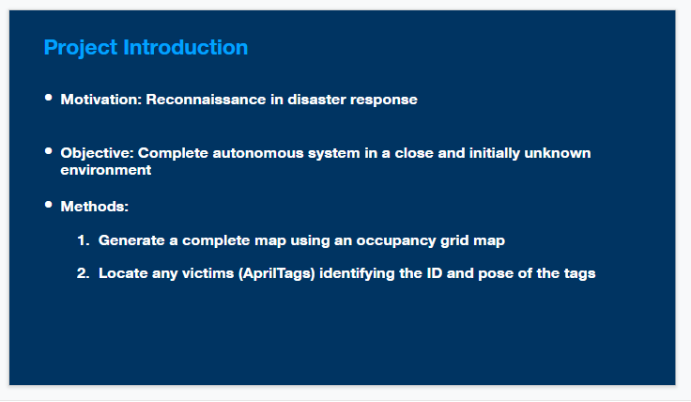

Slide 3
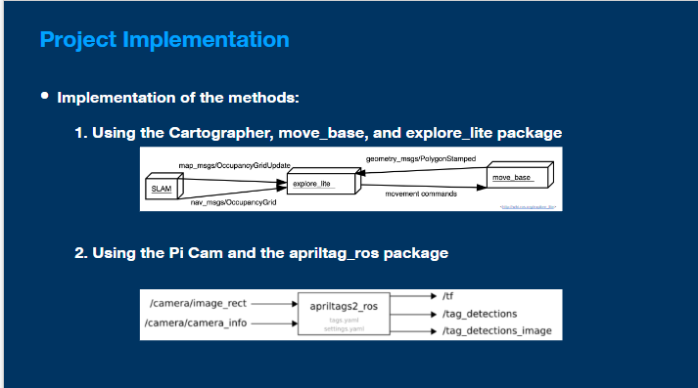

Slide 4
Main problem
The lidar and camera have different range

Slide 5
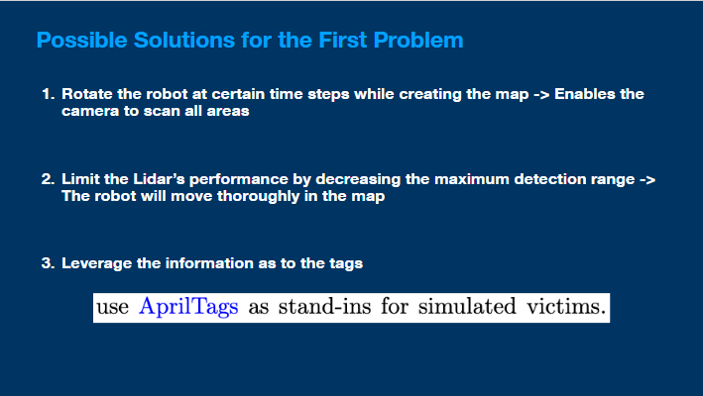
The strategy we have already seen
It will cost a lot of time
Waste of hardware performance

Slide 6
Our plan
Tae start with there
Make assumption, all Apriltag are on the vertical face.
(during the check-board carl~ we find the camera cannot detect the horizontal tag, because of the angle. So……)
Our Strategy: Only scan vertical faces.

Slide 7
Details Steps
1: build the occupency map.
(with…package…)
(to maximize the use of lidar performance)
2: plan a route along all walls. (how to generate the route, distance)
3: let robot drive along this route, and scan the tag.(two method)
4: processing data

Slide 8
Use white board to show the process.
planA Taoran want to explain
planB Tae explain this

Slide 9
About processing data
Coordinate transformation (different framware)
proper filter to reduce error

Slide 10
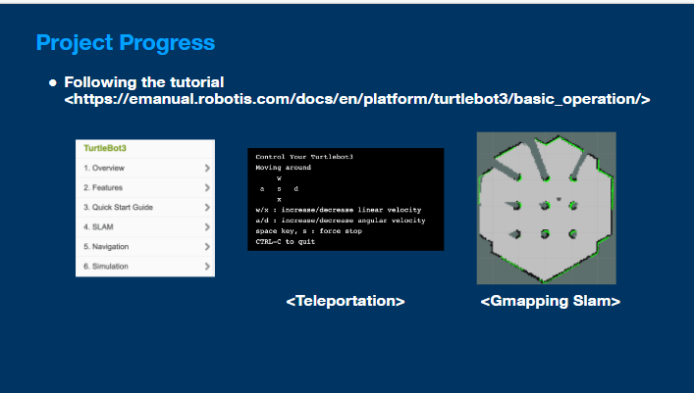
AZHAR start with there
Maybe with taoran

Slide 11
Video about slam, fronter base exp (fake)

Slide 12
May be camera and April tag? If I finish tonight

Slide 13
Reference

